Slide 1
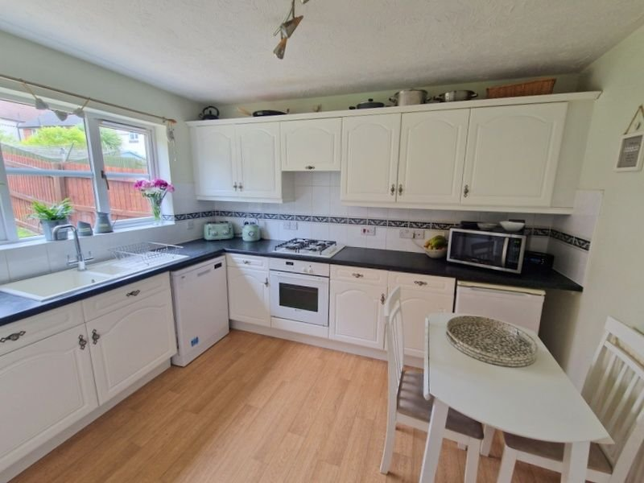
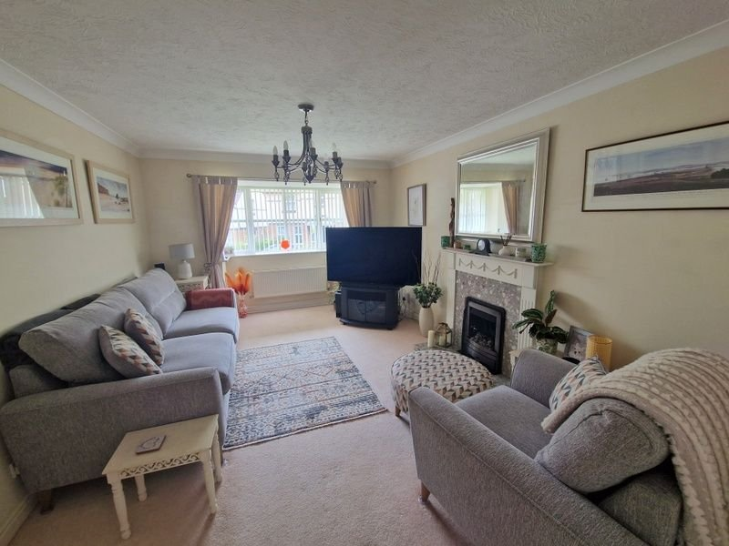
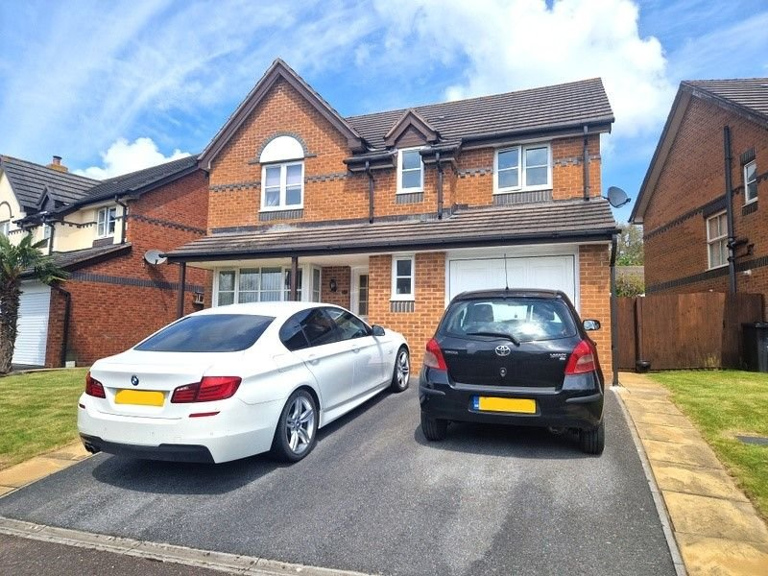
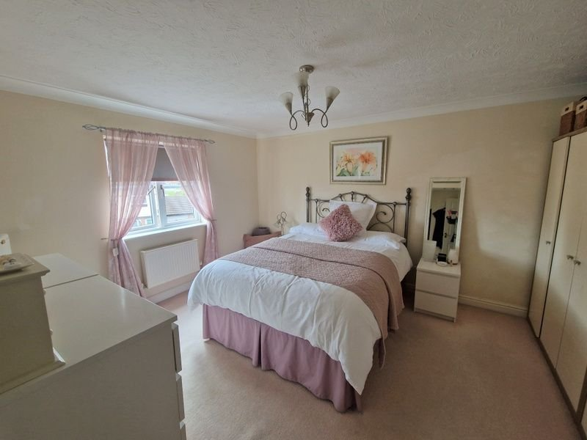
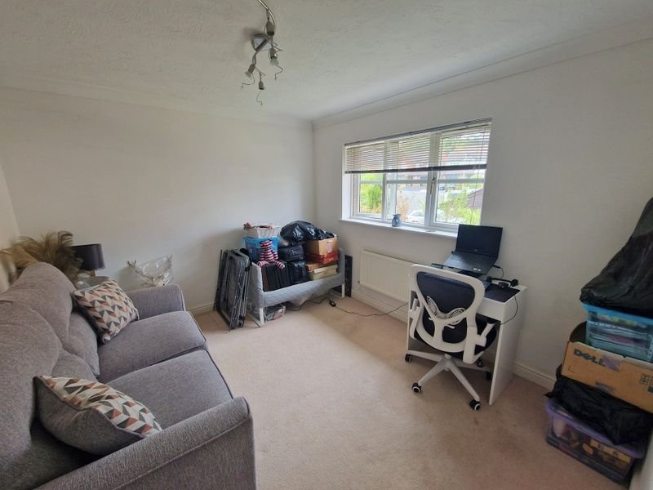
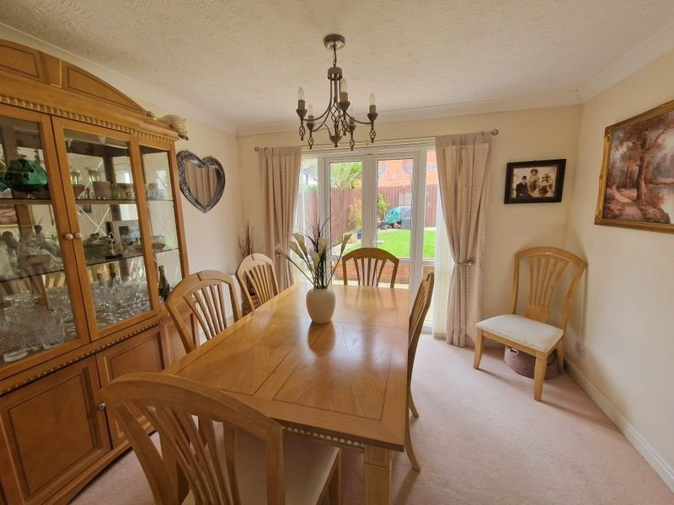
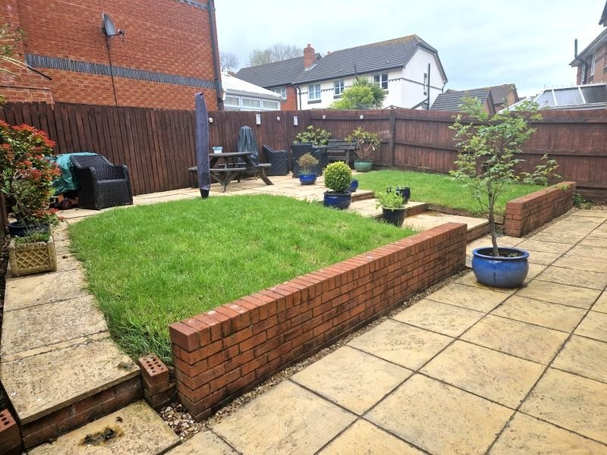
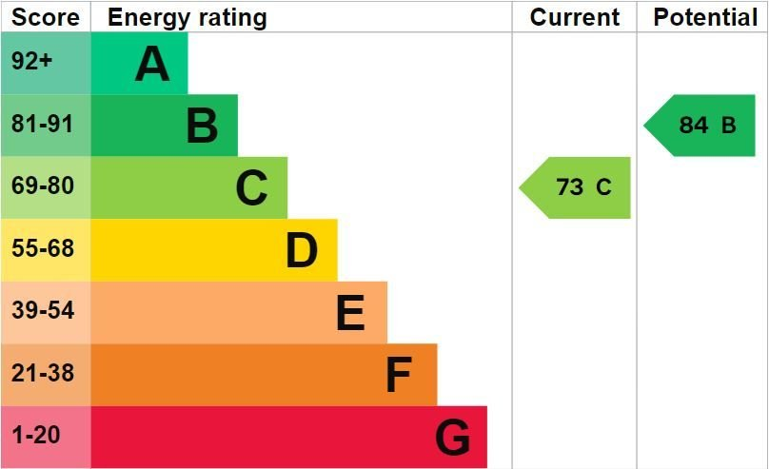
www.pennys.net
17 St Briac Way, Exmouth, EX8 5RL
GUIDE PRICE £499,950
TENURE Freehold
A Well Presented Detached House Located In A Desirable Location With Attractive Gardens Double Width Drive And Garage
Sitting room, Separate dining room • Kitchen/breakfast room • Utility room • Ground floor cloakroom/WC • Four good size bedrooms • En-suite shower room/WC, Family bathroom/WC • Gas central heating, Double glazing • Super family home
Pennys Estate Agents Limited for themselves and for the vendor of this property whose agents they are give notice that:- (1) These particulars do not constitute any part of an offer or a contract. (2) All statements contained in these particulars are made without responsibility on the part of Pennys Estate Agents Limited. (3) None of the statements contained in these particulars are to be relied upon as a statement or representation of fact. (4) Any intending purchaser must satisfy himself/herself by inspection or otherwise as to the correctness of each of the statements contained in these particulars. (5) The vendor does not make or give and neither do Pennys Estate Agents Limited nor any person in their employment has any authority to make or give any representation or warranty whatever in relation to this property.
PENNYS ESTATE AGENTS
2 Rolle House, Rolle Street, Exmouth, Devon, EX8 2SN
Tel: 01395 264111 EMail: help@pennys.net

Slide 2
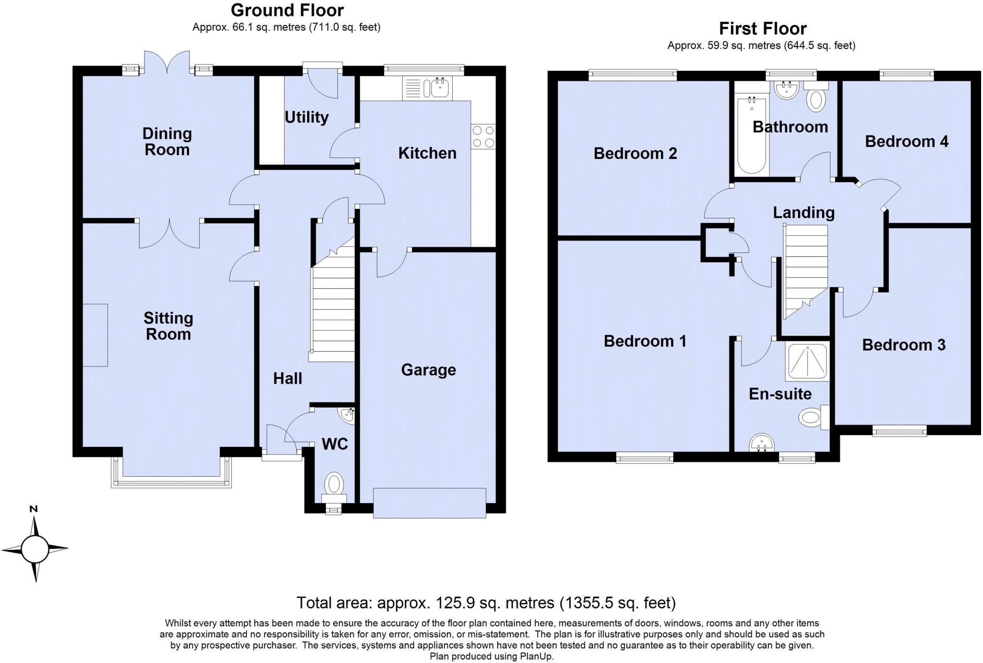
17 St Briac Way, Exmouth, EX8 5RL
Pillared entrance canopy with glazed panelled front door giving access to reception hall. Radiator. Stairs rising to first floor landing with useful understairs storage cupboard beneath.
GROUND FLOOR CLOAKROOM/WC: Corner wash hand basin with tiled splashback, WC with push button flush, double glazed window with patterned glass.
SITTING ROOM: 5.05m x 3.4m (16'7" x 11'2") Attractive room with double glazed square bay window overlooking the front elevation. Fire surround housing gas pebble effect living flame fire with marble hearth and matching inset. TV point, telephone point, two radiators. Double doors to:
DINING ROOM: 3.4m x 2.79m (11'2" x 9'2") (also access to reception room) With picture windows and double glazed double doors overlooking and opening onto the rear garden. Radiator.
KITCHEN/BREAKFAST ROOM: 3.43m x 2.69m (11'3" x 8'10") Fitted range of pattern worktops with inset one and quarter bowl single drainer sink unit with cupboards, drawer units and appliance space beneath worktops. Tiled surrounds. Inset four ring gas hob with built-in oven below and extractor hood over. Double glazed window overlooking the rear garden. Radiator. Door to garage. Wall mounted cupboards and door to:
UTILITY ROOM: 1.93m x 1.75m (6'4" x 5'9") With pattern worktop having inset single drainer sink unit. Cupboards and plumbing for automatic washing machine and appliance space beneath. Wall mounted cupboards, extractor fan, splashback and tiled surround. Radiator. Part glazed door to the rear garden.
FIRST FLOOR LANDING: Radiator. Access to roof space via loft ladder. Airing cupboard, water cylinder and slatted shelving over.
BEDROOM 1: 4.34m x 3.4m (14'3" x 11'2") An excellent main bedroom with feature wall arch giving access to the shower room/WC. Radiator. Double glazed window to front elevation.
EN-SUITE SHOWER ROOM/WC: Comprising shower cubicle with Mira shower unit and pedestal wash hand basin, WC with push button flush. Tiled splashback areas. Radiator. Light shaver socket. Mirror fronted medicine cabinet. Double glazed window with pattern glass.
BEDROOM 2: 3.4m x 2.79m (11'2" x 9'2") max. overall measurement. Double glazed window to rear elevation. Radiator.
BEDROOM 3: 3.94m x 2.74m (12'11" x 9'0") Double glazed window to front elevation. Radiator.
BEDROOM 4: 2.74m x 2.59m (9'0" x 8'6") Double glazed window to rear elevation. Radiator.
BATHROOM/WC: 2.06m x 1.78m (6'9" x 5'10") Comprising bath with shower attachment, pedestal wash hand basin, WC with push button flush. Tiling to splashback areas. Radiator. Mirror fronted medicine cabinet. Light shaver socket. Ceiling extractor fan. Double glazed window with pattern glass.
OUTSIDE: To the front of the property is a lawned garden with driveway into single garage. Patio side path gate gives access through to the rear garden. The rear garden is attractively planned and landscaped enjoying patio sun terrace areas ideal for outside entertaining, lawned area of gardens, outside cold water tap and garden shed to the side of the property.
GARAGE: 5.03m x 2.72m (16'6" x 8'11") Power and light connected, and also houses the Vaillant gas boiler for hot water and central heating. Electric consumer unit and door giving direct access into the property.
FLOOR PLAN:

